Slide 1
A FAILING GRADE
SCHOOLS AND APPAREL TRADEMARKS
There are number of interesting issues currently being litigated in school trademark cases

Slide 2
A FAILING GRADE
SCHOOLS AND APPAREL TRADEMARKS
There are number of interesting issues currently being litigated in school trademark cases
These raise concerns for those who represent clients involved in academic trademarks

Slide 3
A FAILING GRADE
SCHOOLS AND APPAREL TRADEMARKS
There are number of interesting issues currently being litigated in school trademark cases
These raise concerns for those who represent clients involved in academic trademarks
The issues being raised here have broader implications for trademark litigation generally

Slide 4
A FAILING GRADE
SCHOOLS AND APPAREL TRADEMARKS
But before we get to that, how about some Lil Wayne?

Slide 5
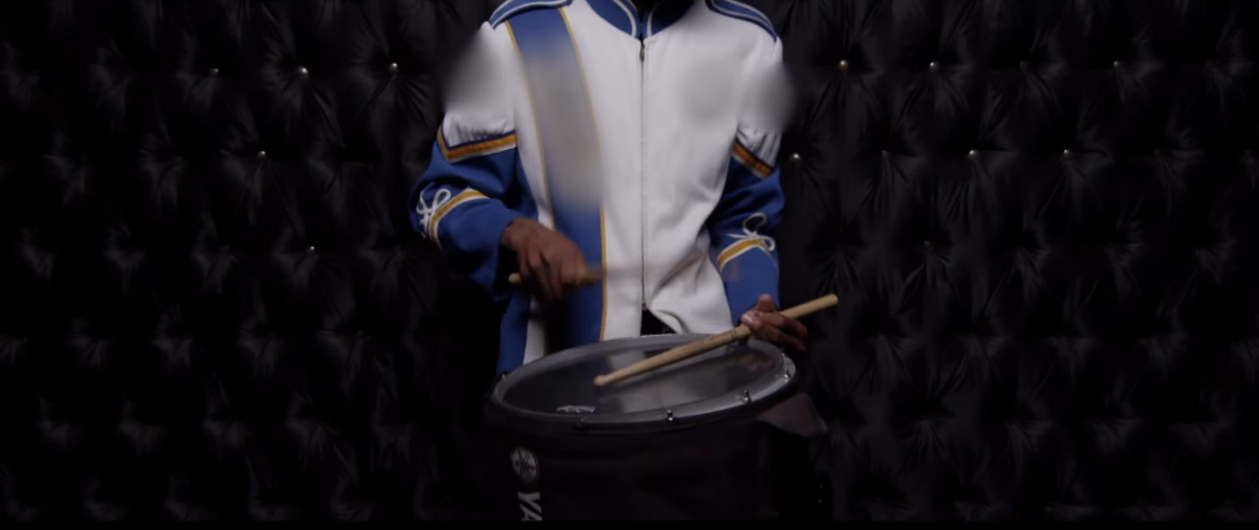
A FAILING GRADE
SCHOOLS AND APPAREL TRADEMARKS
The Bands A Make Her Dance Video Today

Slide 6
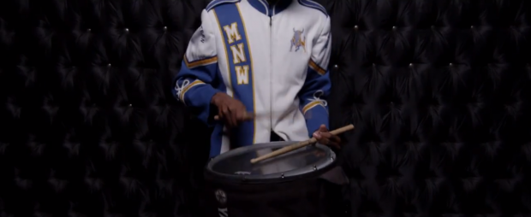
A FAILING GRADE
SCHOOLS AND APPAREL TRADEMARKS
The Bands A Make Her Dance Pre-Blurring Version

Slide 7
A FAILING GRADE
SCHOOLS AND APPAREL TRADEMARKS
Who is Prep Sportswear?
Apparel stores for many thousands of academic institutions across the nation
Hard line position on licensing, i.e., they don’t take licenses

Slide 8
A FAILING GRADE
SCHOOLS AND APPAREL TRADEMARKS
Two Pronged attack:
  Separating trademark rights in educational services from rights in apparel and other goods
  Attacking the apparel/goods rights for lack of evidence of trademark rights or failure to enforce rights

Slide 9
A FAILING GRADE
SCHOOLS AND APPAREL TRADEMARKS
First Prong: Separating trademark rights in educational services from rights in apparel and other goods
The Plaintiff admits that it does not have registrations for the marks related to apparel. Instead, the Plaintiff argues that it needs no such registrations. That is not the case. Because the Plaintiff does not have registered marks for apparel, it must show that it used the marks in commerce prior to the Defendant's use.
Savannah College of Art and Design, v. Sportswear, Inc. 2015 U.S. Dist. LEXIS 100813 *5

Slide 10
A FAILING GRADE
SCHOOLS AND APPAREL TRADEMARKS
First Prong: Separating trademark rights in educational services from rights in apparel and other goods
The Court agrees with Defendant that notwithstanding Plaintiff’s registration of the BELEN JESUIT Text Mark with the Principal Registry, it is undisputed that this Mark was registered solely for the purpose of providing educational services, and this protection does not extend to other goods and services, specifically the sale of clothing and apparel.
Belen Jesuit Preparatory Academy v. Sportswear, Inc. (Case 1:15-cv-22194-UU) (Summary Judgment Order of 5-3-2016, p. 11).

Slide 11
A FAILING GRADE
SCHOOLS AND APPAREL TRADEMARKS
Second Prong: Attacking the apparel/goods rights for lack of evidence of trademark rights or failure to enforce rights
13. At trial, Plaintiff failed to show it used any of the Alleged Text Marks in commerce in connection with the sale of clothing before 2008, the date when Defendant first sold goods printed with the terms. Transcript 1 at 112:1-24; Plaintiff's Exhibit No. 21; D.E. 73-1 ¶ 19.
….
20. Based on the totality of the circumstances, Plaintiff failed to carry its burden of proving its Alleged Text Marks are valid and entitled to protection as a matter of law.
Belen Jesuit Preparatory Sch., Inc. v. Sportswear, Inc., 2016 U.S. Dist. LEXIS 125851, 10-13 (S.D. Fla. 2016)

Slide 12
A FAILING GRADE
SCHOOLS AND APPAREL TRADEMARKS
Belen loses its registered mark claim and goes to trial on common law rights. Belen loses after a bench trial and chooses not to appeal.
SCAD’s entire case is disposed of on summary judgment. SCAD’s appeal is currently pending before the 11th Circuit. (Case No. 15-13830).

Slide 13
A FAILING GRADE
SCHOOLS AND APPAREL TRADEMARKS
What’s wrong with these decisions dismissing counts for registered mark infringement?

Slide 14
A FAILING GRADE
SCHOOLS AND APPAREL TRADEMARKS
It sets a dangerous precedent by reducing the entire likelihood of confusion analysis to a single factor and making that factor dispositive

Slide 15
A FAILING GRADE
SCHOOLS AND APPAREL TRADEMARKS
THE LOC FACTORS:
the strength or distinctiveness of the mark;
the similarity of the two marks;
the similarity of the goods and services that the marks identify;
the similarity of the facilities that the two parties use in their businesses;
the similarity of the advertising the two parties use;
the defendant's intent; and
actual confusion.
Lone Star Steakhouse & Saloon, Inc. v. Alpha of Va., Inc., 43 F.3d 922, 933 (4th Cir. Va. 1995)

Slide 16
A FAILING GRADE
SCHOOLS AND APPAREL TRADEMARKS
Relatedness of the goods/services isn’t even one of the two most important factors; see e.g. Lone Star, 122 F.3d at 1382 (11th Cir. Ga. 1997) (“Of these seven factors, we consider the type of mark and the evidence of actual confusion to be the two most important factors.”)

Slide 17
A FAILING GRADE
SCHOOLS AND APPAREL TRADEMARKS
It sets a dangerous precedent by invading the province of the jury
SPECTRUM:
Plaintiff SJ
Jury Question
Defendant SJ
Some Connection? Goods/Services
Completely Unrelated
Goods/Services
Same
Goods/Services

Slide 18
A FAILING GRADE
SCHOOLS AND APPAREL TRADEMARKS
Should this be a jury question?
“falsely suggesting affiliation with the trademark owner in a manner likely to cause confusion as to source or sponsorship constitutes infringement.” Prof'l Golfers Ass'n of Am. v. Bankers Life & Cas. Co., 514 F.2d 665, 670 (5th Cir. 1975)
In granting summary judgment on the educational services claim, isn’t the court necessarily concluding that no one would be likely to conclude that a school sponsors or licenses apparel?

Slide 19
A FAILING GRADE
SCHOOLS AND APPAREL TRADEMARKS
These decisions are also difficult, if not impossible, to reconcile with 11th Circuit precedent
The UGA v. Laite decision is on point. Univ. of Ga. Ath. Ass'n v. Laite, 756 F.2d 1535, 1547 (11th Cir. 1985)

Slide 20
A FAILING GRADE
SCHOOLS AND APPAREL TRADEMARKS
Any questions?
Stephen Luther
Allen, Dyer, Doppelt, Milbrath & Gilchrist, P.A.
Sluther@addmg.com
407 841-2330
255 South Orange Avenue, Suite 1401
Orlando, FL 32801

